Slide 1



Test Automation using UiPath Test Suite – Developer Series
Part 2 of 4

Slide 2



Meet today’s team:
Diana Gray
Community Marketing Manager AMER
@UiPath
Atul Trikha
RPA Architect, COE Lead & Account Chief Technologist @Peraton
Sreenivasa Adathakula
Test Automation Lead @Peraton

Slide 3
About today’s UiPath developer meeting:
AMER Developer Community sessions
Managed by UiPath MVPs in Canada, Latin America & USA
You are encouraged to network with MVPs and share your LinkedIn in the chat box. We want to get to know you
These sessions are for you to engage with us on topics that interest you or that you want to share with the UiPath Developer Community
Please use the chat to place questions until Q&A
If you have any topics that you want us to cover, please email diana.gray@uipath.com

Slide 4



Date/Time | Topic | Status
July 12, 5PM EDT | Test Automation using UiPath Test Suite - Developer Series - Part 1 of 4 | Recorded
July 19, 5PM EDT | Test Automation using UiPath Test Suite - Developer Series - Part 2 of 4 | Happening
July 26, 5PM EDT | Test Automation using UiPath Test Suite - Developer Series - Part 3 of 4 | Register now
Aug 2, 5PM EDT | Test Automation using UiPath Test Suite - Developer Series - Part 4 of 4 | Register now
Register for Events at community.uipath.com

Slide 5

Test Automation using UiPath Test Suite 4 Parts Developer Series
Part 1: Building Blocks, Test Suite Product Overview
Part 2: UiPath Test Suite Family of Products
Part 3: Deep Dive into Test Suite capabilities
Part 4: Open Discussion and Wrap up

Slide 6
Part 2: UiPath Test Suite Family of Products
Create a simpler, smoother, and more productive testing experience.
UiPath Test Manager: Manage tests with comprehensive test planning, defect reporting, role-based access controls, and requirement traceability
UiPath Studio: Automate tests and test data generation by leveraging UiPath production-grade automation capabilities
UiPath Orchestrator: Distribute tests to schedule, monitor, and store dynamic test data and test execution & analyze detailed results
UiPath Test Robots: Execute tests on multiple machines in parallel and receive reports back
How to get started?
Notes:
UiPath Test Manager: Manage tests with comprehensive test planning, defect reporting, role-based access controls, and requirement traceability
UiPath Studio: Automate tests and test data generation by leveraging UiPath production-grade automation capabilities
UiPath Orchestrator: Distribute tests to schedule, monitor, and store dynamic test data and test execution & analyze detailed results
UiPath Test Robots: Execute tests on multiple machines in parallel and receive reports back
Guidance in setting the environment for Test Automation

Slide 7
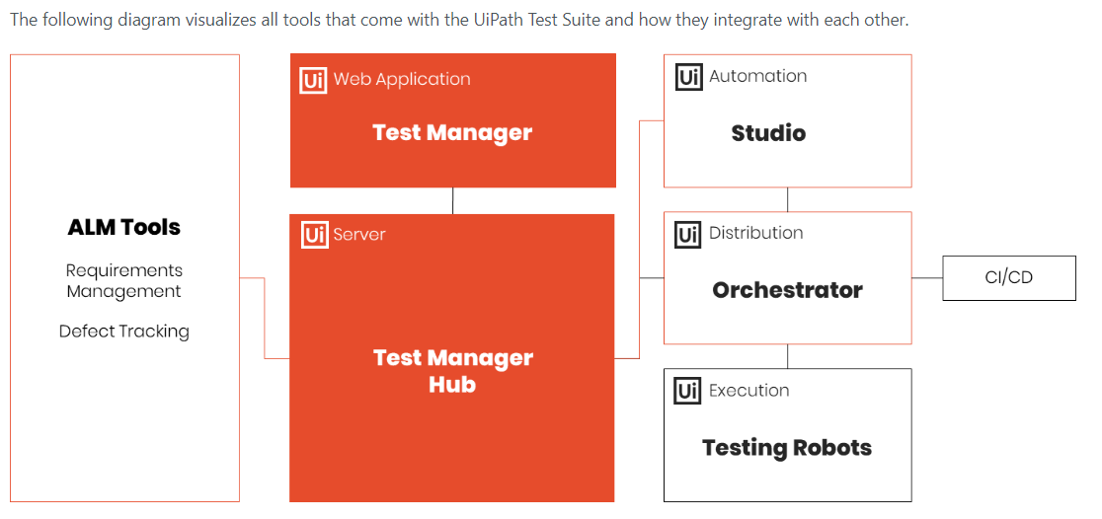
UiPath Test Suite
Notes:
Studio
It enables you to create automated tests just like you would create RPA workflows.
Orchestrator
UiPath Orchestrator is a web application that enables you to orchestrate robots in executing repetitive business processes and test cases. Orchestrator manages the resources to be used in automation and access to them through support for hierarchical structuring combined with fine-grained role assignment. It acts as an integration point with third-party solutions and applications.
Test Manager Hub
The main purpose of Test Management Hub is to integrate the UiPath Test Suite with third-party ALM tools. Through its flexible connector architecture, it can be used to integrate any ALM tool that provides a compatible API in order to:
Assign test cases to requirements, user stories, or any other artefact.
Create bug reports in an external bug tracking systems supplemented with log information and screenshots from test executions.
Test Manager
A web application hosted by Test Management Hub that allows you to manage your testing process.
Testing Robots
The UiPath Robot is the execution host that runs processes designed in UiPath Studio. By leveraging UiPath test robots, you can execute tests on-demand, continuously, and at scale

Slide 8
Setup and Configuration

Slide 9
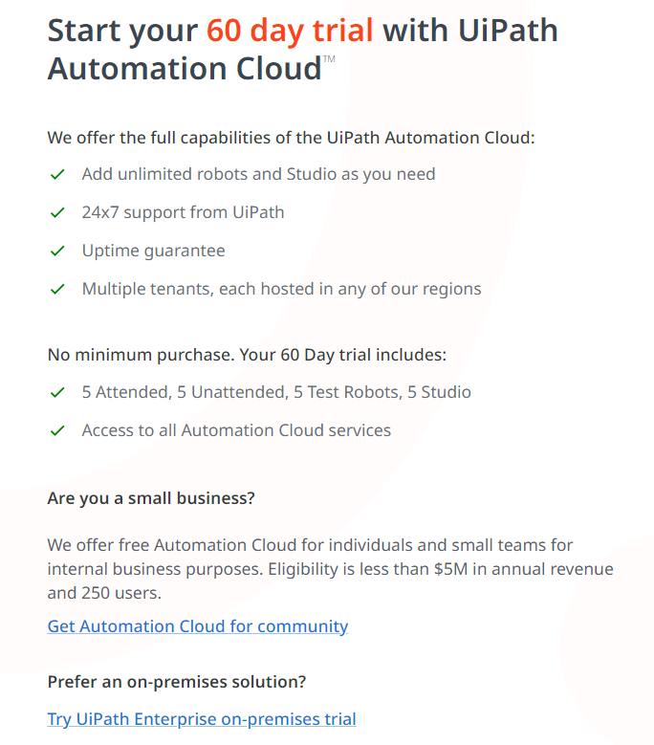
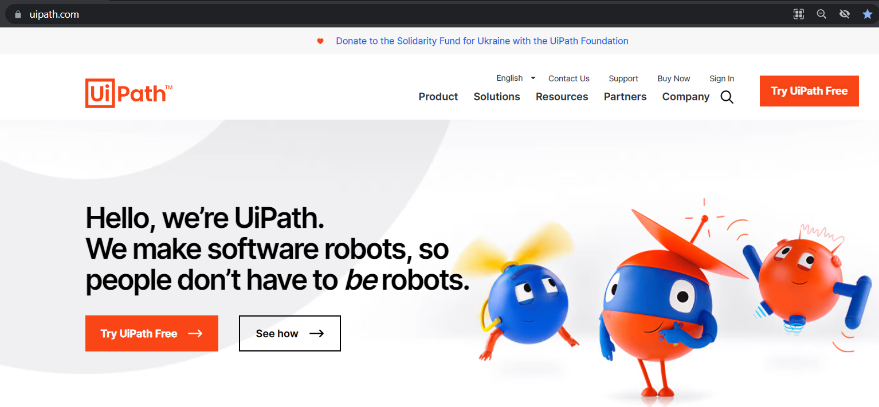
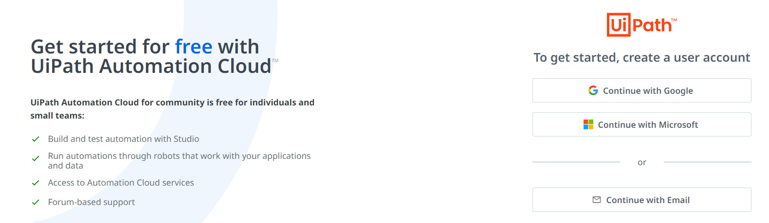
Where to Start?
1
https://www.uipath.com/
2
3

Slide 10
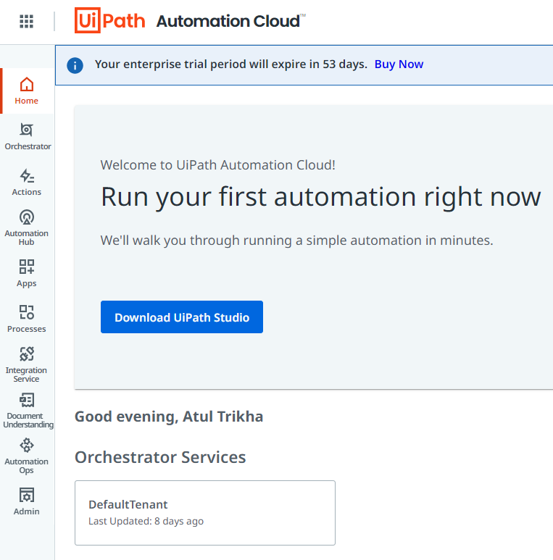
Automation Cloud
1
3
2

Slide 11
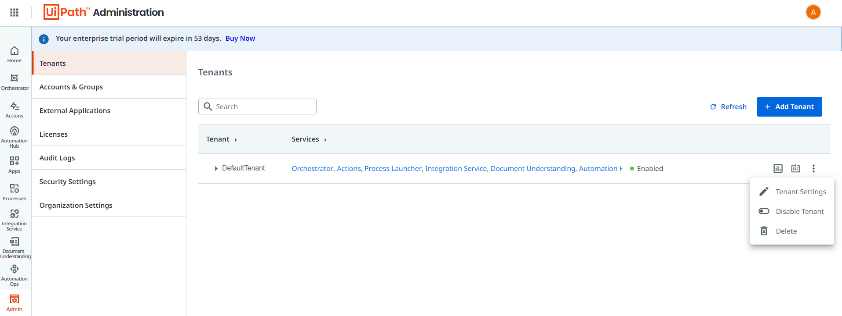
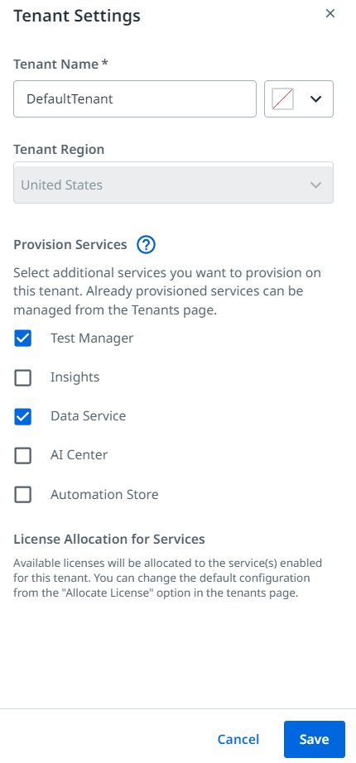
Test Manager and Data Service (Tenant Settings)
2
1
3

Slide 12
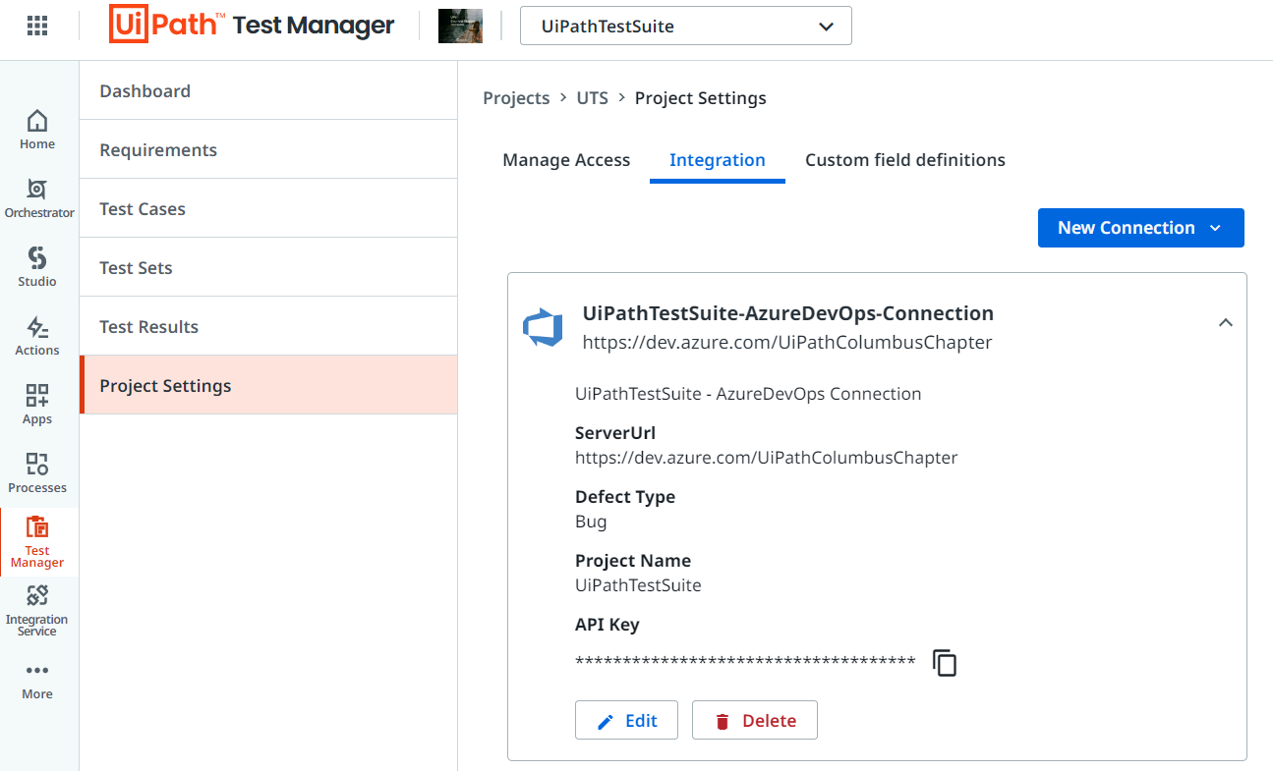
Integrate Test Manager with ALM
2
3
1

Slide 13
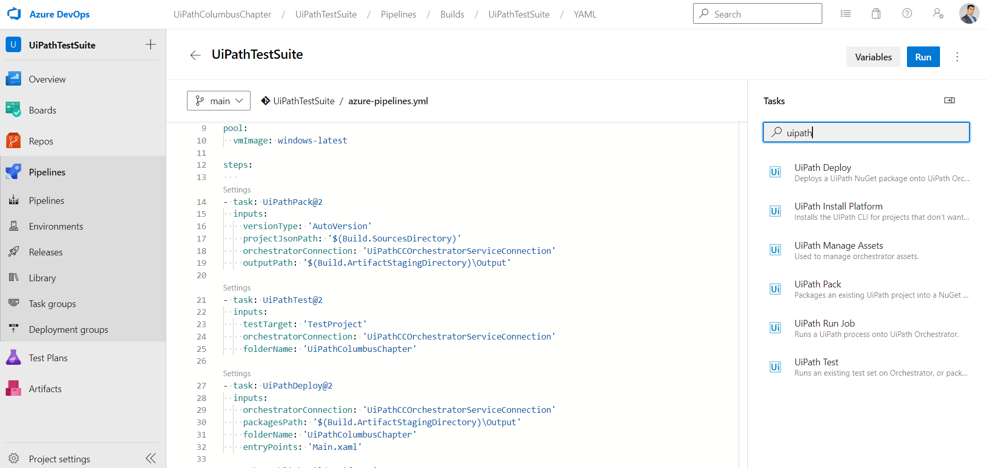
CICD Pipelines using Azure DevOps
https://www.uipath.com/community/rpa-community-blog/how-to-implement-cicd-pipeline-using-azure-devops-pipelines

Slide 14
UiPath Test Manager
Manage testing your way
Notes:
UiPath Test Manager is a web application that allows you to easily manage your testing process by addressing the following functional areas:
Assigning automation from Studio to test cases.
Assign test cases to requirements.
Dashboards to get a quick overview of your test results.
Reporting
Manual testing
Creating defects from test results

Slide 15
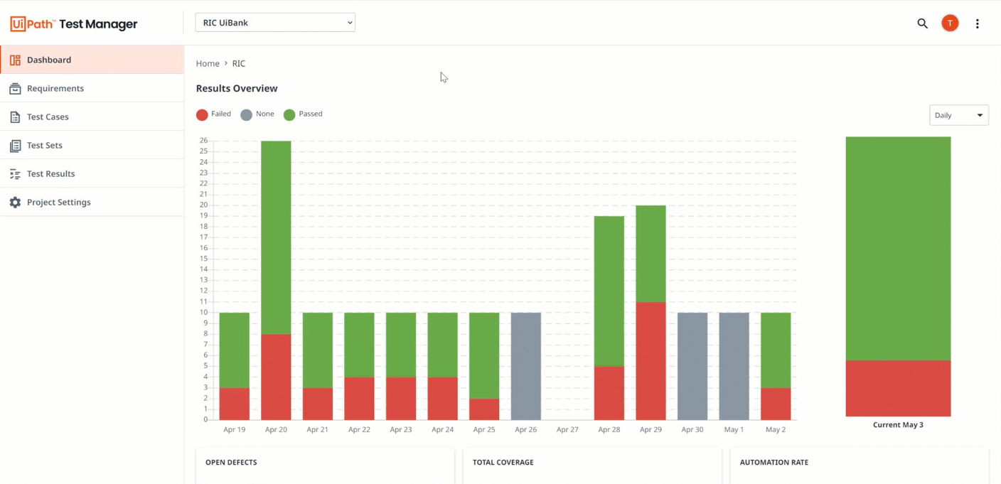
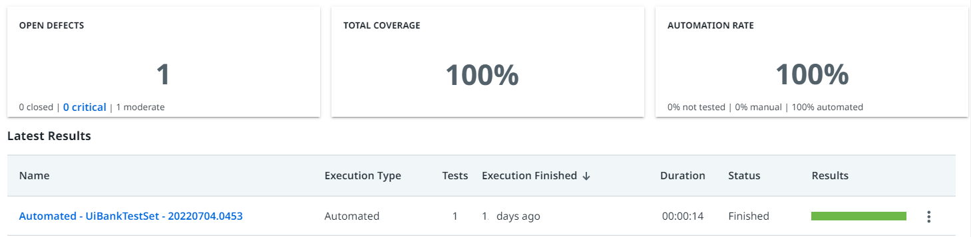
Manage the health of your team’s automations
Notes:
Forward IV Video
If we have to describe in one single sentence what test management is, I would answer your question with a question and the question is, Are you ready to release?
Because that's really what test management does. It gives you an answer to the question, are we ready to release?
Are we ready to release that SEP system? Are we ready to release that RPA into production?
Because it's the single place where all the information comes together--
How many test cases have you built?
How many have you executed?
How many test cases passed?
How many failed?
Defect metrics and all this information that you need to make that decision are in the test manager.

Slide 16
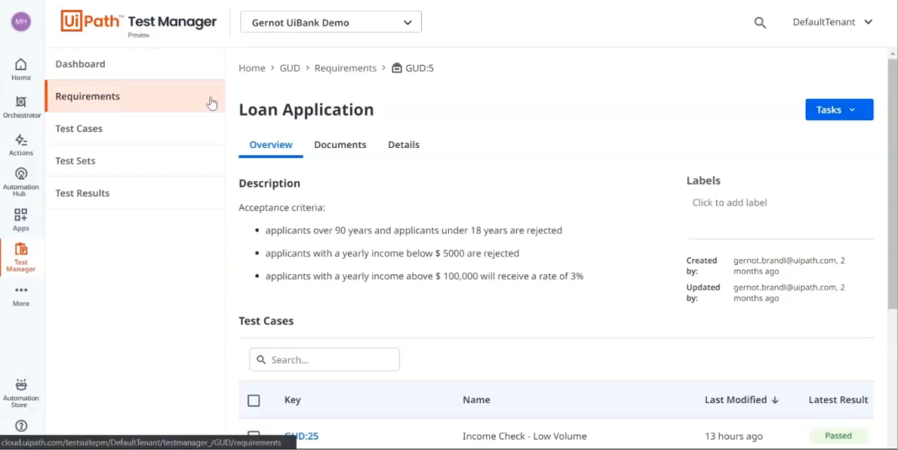
Ensure every requirement is fully tested
Whether automated or manual, your tests can be linked to stories, epics, defects, or any other artifact type in your existing Application Lifecycle Management tools. That ensures traceability and full test coverage.​
Notes:
Now, when you think about how should we know what we need to test?
Typically, we look at what the software is supposed to do and you could call this requirement, user stories, or whatever you want to call it, but somewhere there is a description of that requirement. It may live in a Jira system, it may live in a database, it may live in the process definition document and you need to be able to access these definitions in order to derive your test cases.

Slide 17
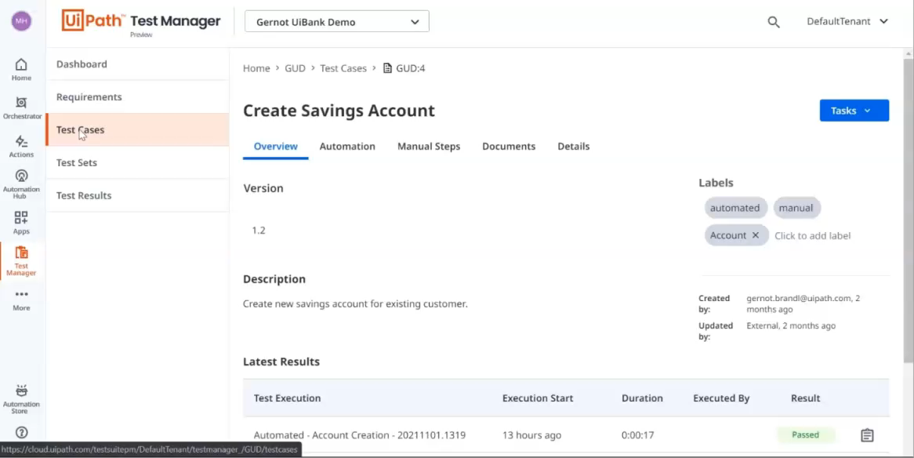
Design great tests, then automate them with drag-and-drop speed
Define the test cases to cover all requirement variations, then document manual tests in Task Capture or build resilient automation in low-code, easy-to-learn Studio.

Slide 18
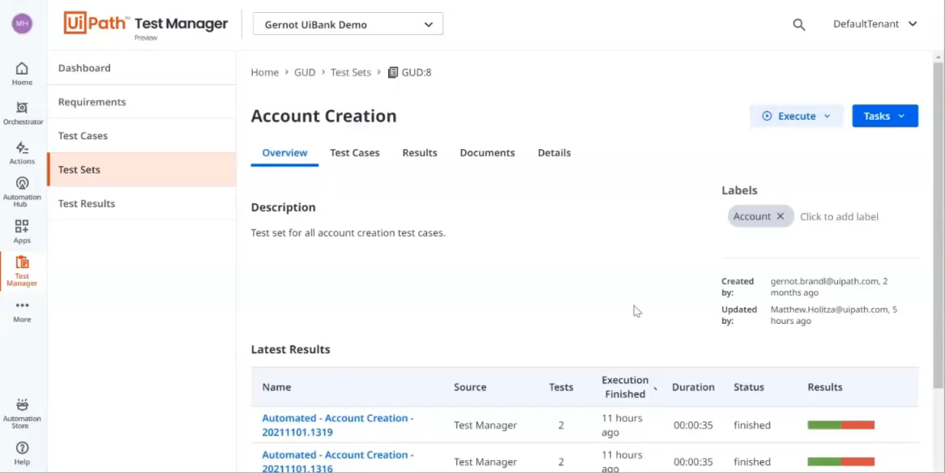
Organize your tests and execute continuously or on-demand
Create logical test sets of application and RPA test cases, then manage how they are executed. Seamless integration with UiPath Orchestrator means you can execute tests directly, on a schedule or via continuous integration triggers.

Slide 19
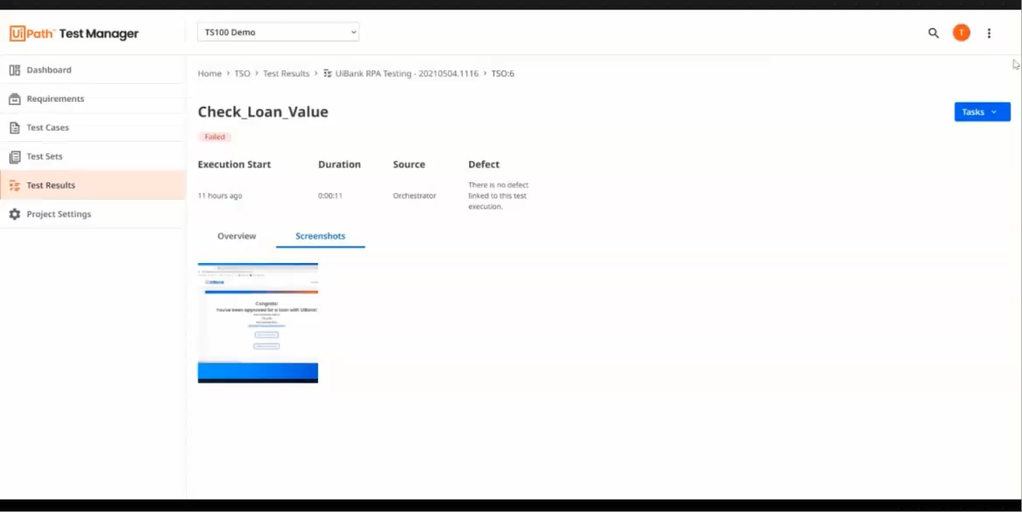
Understand release status instantly and resolve defects faster
Monitor the quality of RPA workflows and applications by tracking test results in real-time.​
Get defects instantly sent to your organization’s issue tracking tool with detailed, visual logging, so developers can triage, and fix rapidly.​

Slide 20
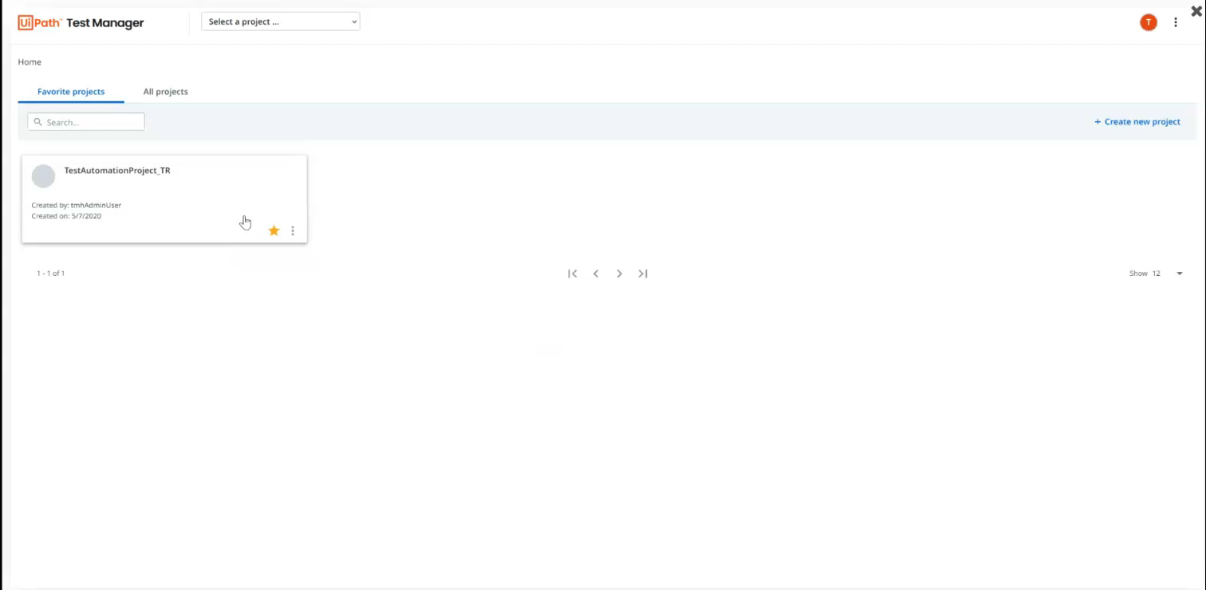
Document with Task Capture
The functionality to create Manual Test Cases is now upgraded with the possibility to document them using Task Capture in order to avoid manually downloading the images and typing titles for each of the included actions. To use this option follow the below steps:
Notes:
UiPath Task Capture is a process discovery tool that helps you document your test cases to avoid manually downloading the images and typing titles for each of the included actions.
Working in the background, the tool captures the performed steps, takes screenshots with every mouse click, and collects smart data about the process statistics (execution time, number of steps, text entries, etc.). You can edit and annotate each screenshot and add information for each step.
Based on the captured data, UiPath Task Capture builds a comprehensive Process Definition Document (PDD) in a .ssp, .docx and .jpg (diagram image) format that can be easily uploaded to Test Manager.

Slide 21
UiPath Studio (Previously Studio Pro)

Slide 22


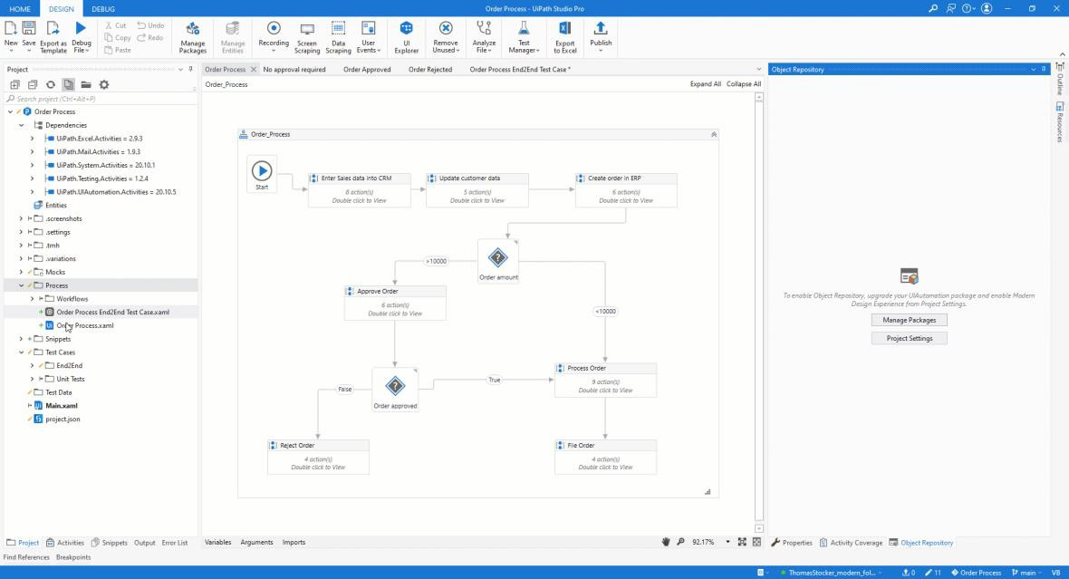
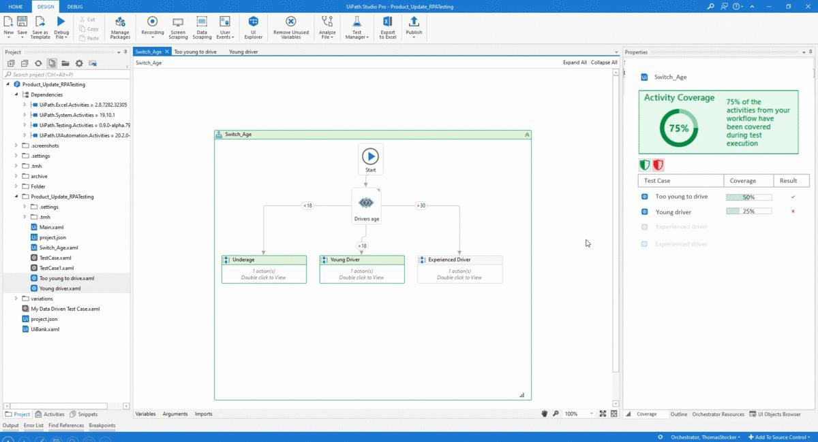

Testing business processes with Studio
Verify the quality of every activity before it’s published
Add Test Cases Directly to your Workflow
Instantly Understand Activity Test Coverage
15

Slide 23
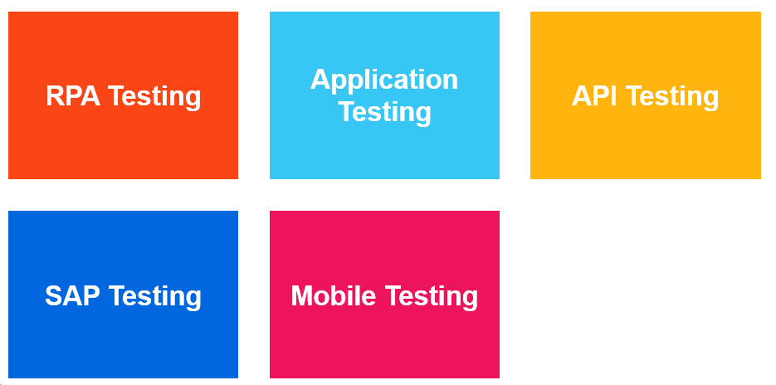
Testing
16

Slide 24
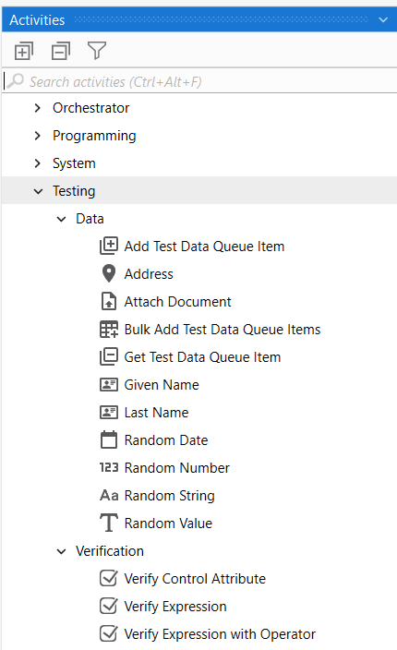
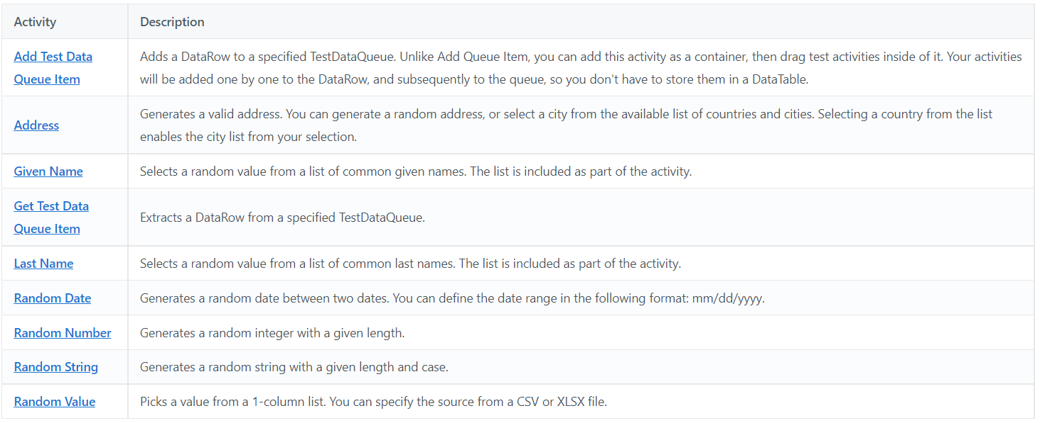
Test Activities
16

Slide 25
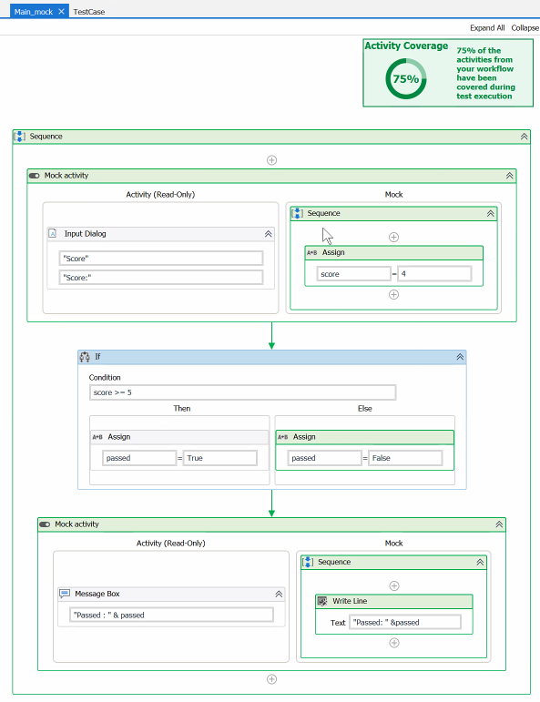
Activity Mocking enables incremental testings
Uncover issues before all activities are ready
Mimic the behavior of any activity
Test complete workflow earlier
16
Notes:
You can create a mock file of your workflow by selecting Mock workflow under test in the Create Test Case window. This creates a copy of your workflow with the name workflowName_mock and stores it in Project > Mocks. This folder mirrors the source workflow file tree structure. For example, if your workflow is stored in the Project tab as production\testFolder01\testCase07.xaml, the correspondent mock file is stored as production\testFolder01\testCase07_mock.xaml.
In a practical scenario, you have an application that writes directly in a database but you want it to write on the screen. You can use Surround with mock to test this specific function, without having to make any changes to your main test case. As a general note, consider using mocks for tests that have permanent effects in production or require special resources.

Slide 26
Data-Driven Testing
Data-driven testing allows you to test your RPA workflows and applications to make sure that the automation can handle multiple scenarios.
When you configure data sources for your data variation, you can choose from the following options:
File, if you want to use Excel and CSV files.
Auto Generate, for test data that is automatically generated to cover as many paths as possible during execution.
Data Service, if you use Data Service entities (Automation Cloud only).
Existing data for any type of data that has already been stored in your project, in the Test Data folder.
Notes:
The key to any good test case is making sure that you have enough input data variations to cover all usage scenarios.

Slide 27
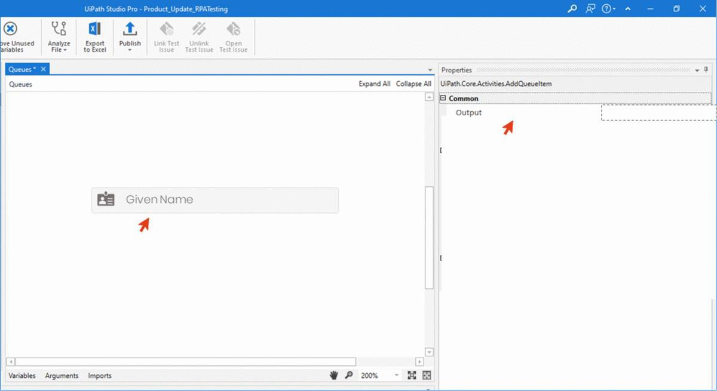
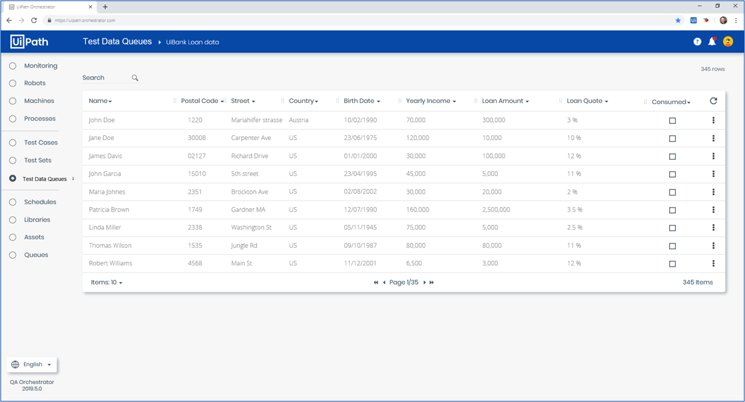
Synthetic Test Data Generation
Prepare your automation for any data variations
UiPath StudioPro
UiPath Orchestrator
Define Test Data Requirements
Manage Test Data Queues

Slide 28

Integration With Data Services
The UiPath Data Service enables you to consolidate and maintain data variations for your test cases. Instead of storing them in Excel files, simply create entities to store the inputs for your test case, and the results you expect for them. What's more, you can add data variations to entities at any time, without needing to update and re-publish your test case! Finally, with advanced access control capabilities, you can control who in your organization can add, edit, and delete data variations.
Notes:
The key to any good test case is making sure that you have enough input data variations to cover all usage scenarios.

Slide 29
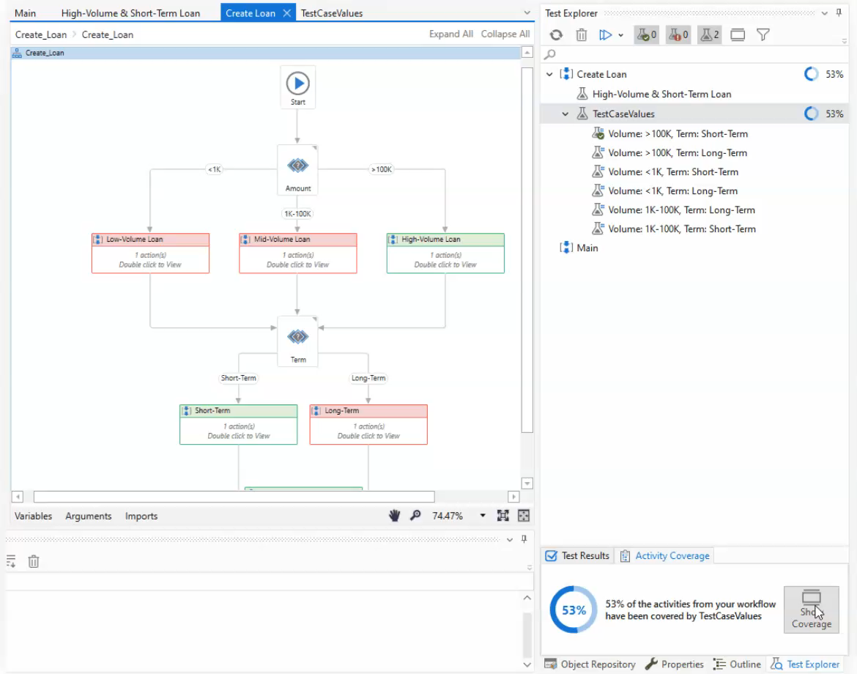
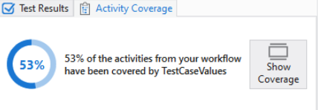
Activity Coverage
Notes:
You can use the workflow activity coverage panel to check whether your test cases have been covered or not and look for redundancies. The test execution results are shown in Test Explorer, in the Activity Coverage panel. The coverage calculations are done by the Robot.

Slide 30

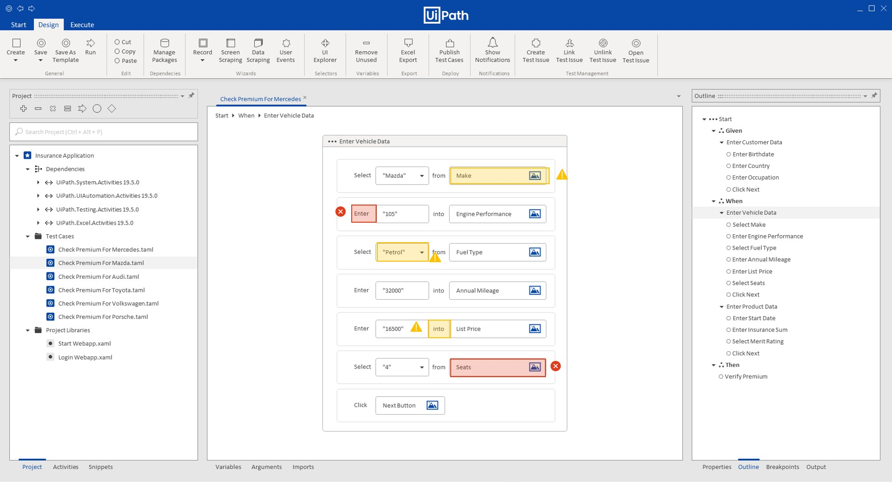
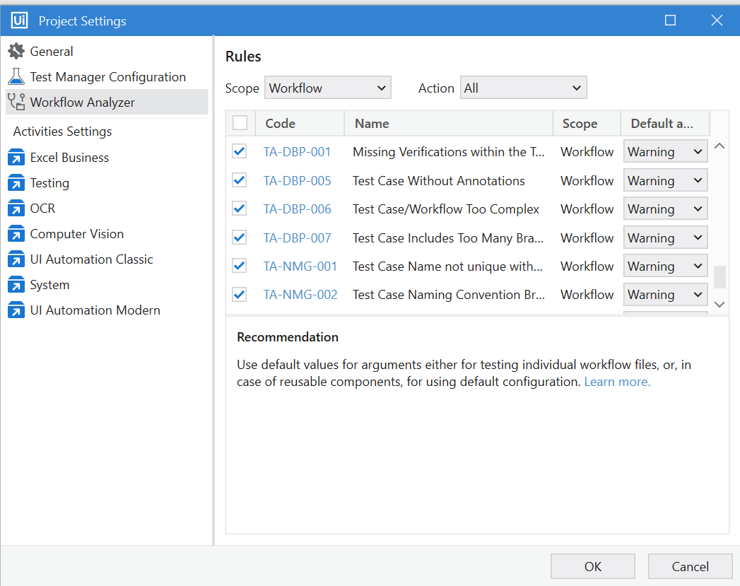
Define and enforce test automation standards
Ensure testing standards are enforced
Define Testing Rules
Enforce Rules According to your Testing Standards

Slide 31

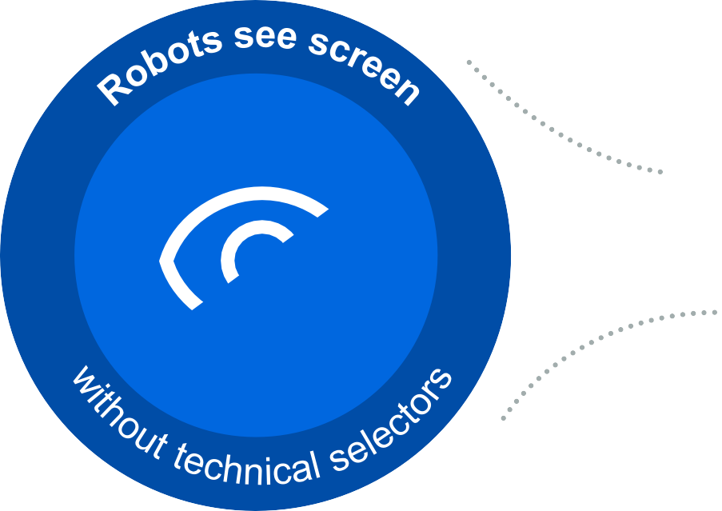




UiPath AI Computer Vision™ enables Robots to “see”, understand and verify any screen
1
Drag-and-drop AI activity, available for use by all Robots
2
Build tests that can see every on-screen element
3
Start automating VDIs,
Web apps and other platforms
Easily enabled in StudioPro with no added fee

Slide 32
UiPath Orchestrator
Notes:
Test Automation in Orchestrator allows you to distribute and manage your tests.

Slide 33
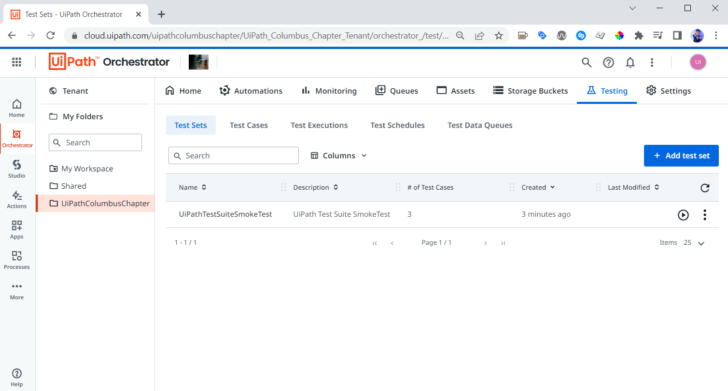
UiPath Orchestrator: Your test execution control center
Continuous
Integration
Distributed Execution with Schedules & Triggers
Version Control
Auditing & Role Management
Test Data Queues
Veracode Certified
21

Slide 34


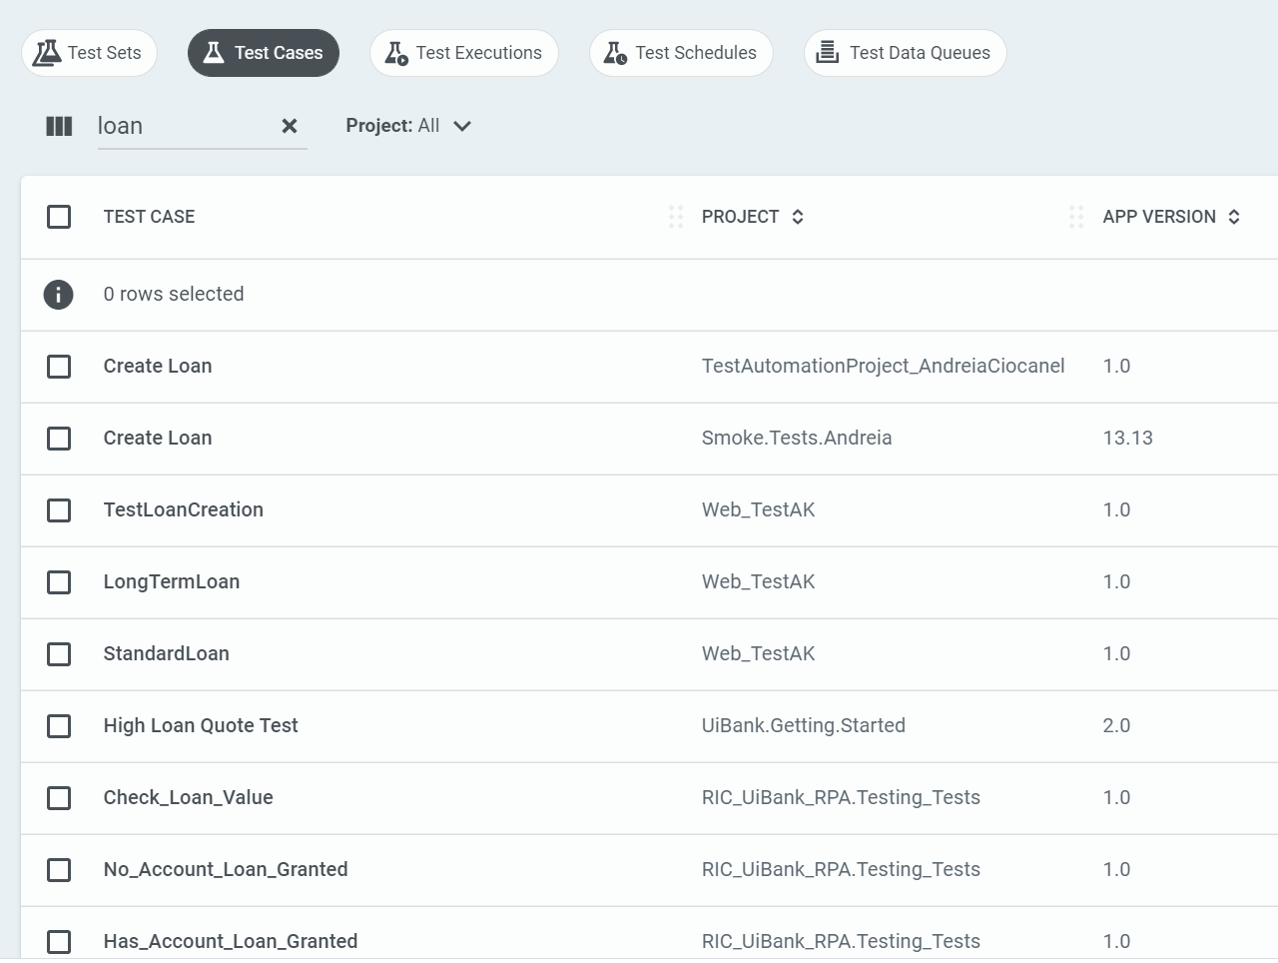
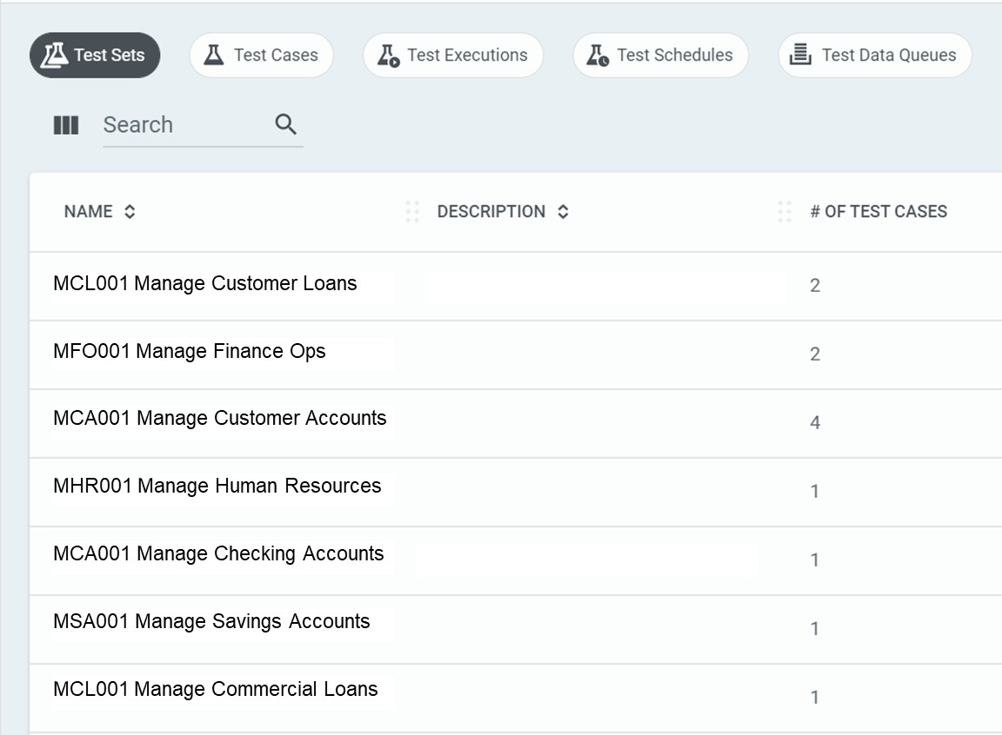
Organize your test cases into logical test sets
Select test cases that evaluate common automations
Add test cases into one or many Test Sets
22

Slide 35
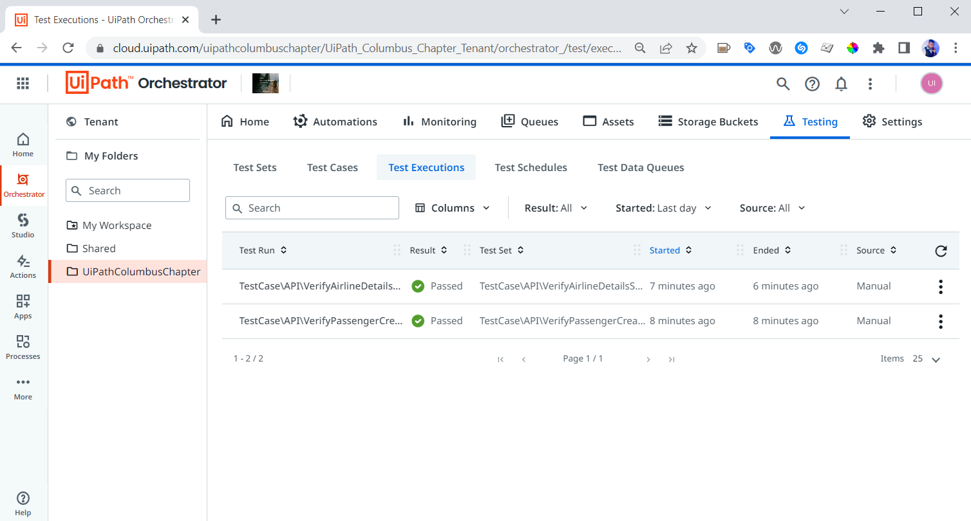
Test Execution
The test executions serve as an immutable record of the execution of any respective test set, at a specific point in time.

Slide 36

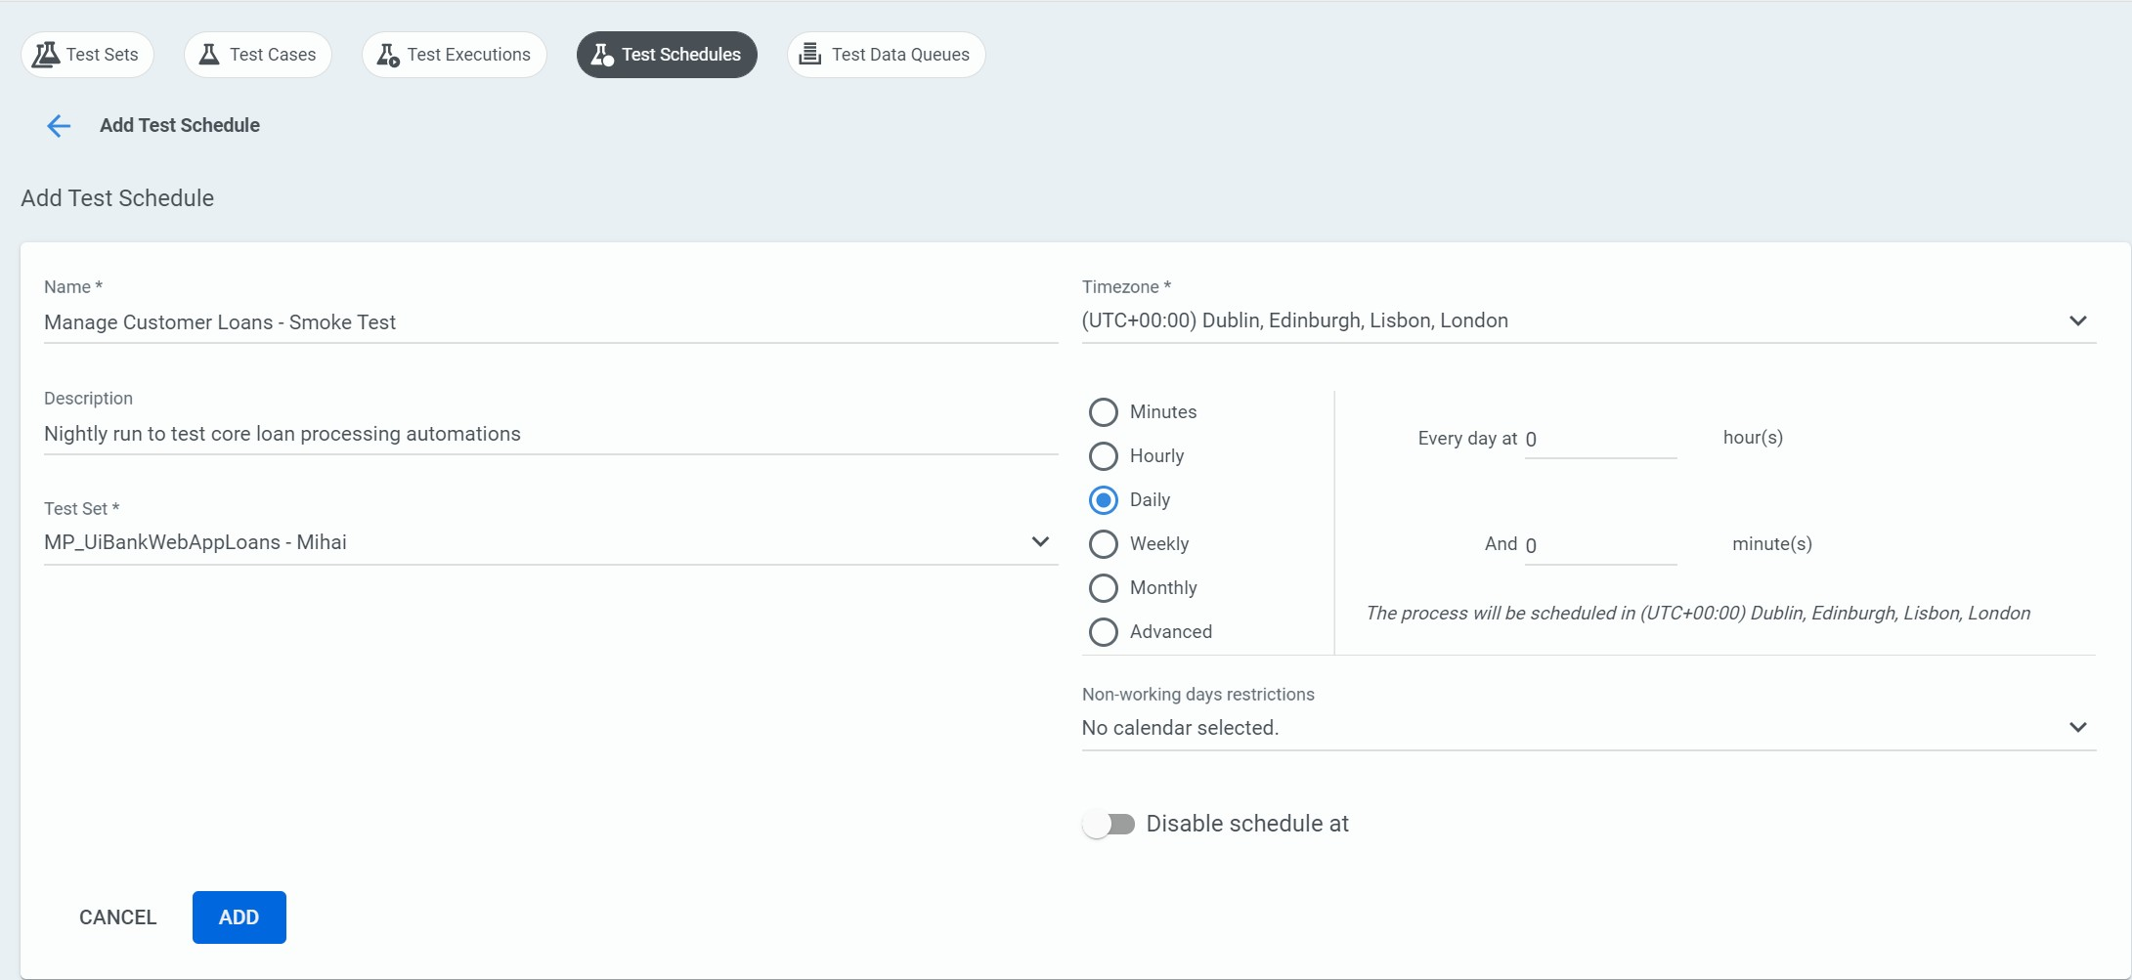
Schedule test sets to execute continuously
Create schedule and select Test Set
Specify frequency and timing of execution

Slide 37
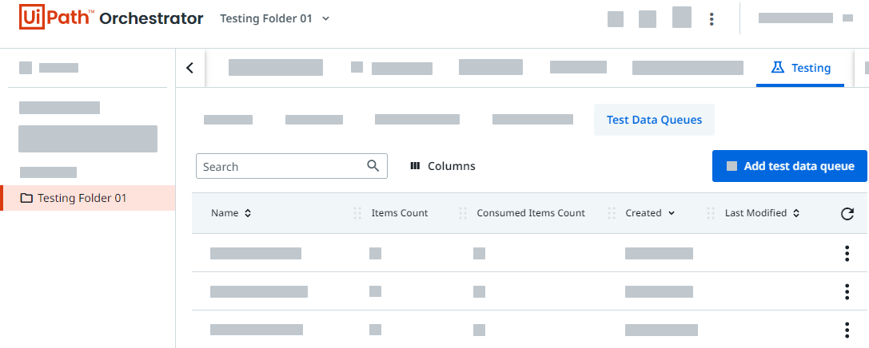
Test Data Queue
Test data queues provide a way to store and manage your test data. The test data queue acts as a container that holds your queue items ready to be consumed through a set of activities. The queue items are uploaded or removed from the test data queue according to a first-in-first-out (FIFO) principle.

Slide 38
UiPath Test Robots

Slide 39

UiPath Test Robots
Purpose built for testing workflows, activities and applications
Provides flexibility in managing and reusing test cases across projects
Enables granular reporting of test case results to third party tools
Enables activity level unit testing out-of-the-box (white box)

Slide 40

vs.
NonProduction
Definition - Works in unattended mode for development purposes only. Cannot execute test cases.
NonProduction robots will run “Process” automations that execute the Main.xaml file of a published .nukpg.
The automation run on a NonProduction robot is the same automation run on a Production robot with no changes
Definition - Works in unattended mode for development and testing purposes. Executes test cases and automated processes.*
Test robots will run “Testing” automations that execute a defined Test Case of a published
.nukpg.
Creating test cases allows developers to add more robust verification and testing to an RPA Process workflow
* - Test Robot support for executing processes available after version 2021.10.

Slide 41
Test Automation Best Practices
Test cases should be independent of each other. One test case should not depend on another test case’s run.
A test case should have one specific purpose only. Each test workflow should contain only one verification.
Every feature should have a unit test. If exceptions are allowed, create a separate test for each test case.
In a Given-When-Then test case structure, if the Given part is getting too extensive and unmanageable, try to redefine the test case. It could need more granularity or refactoring.
Maintain the test cases and update them after any change request.
Consider establishing a Test Management logic to have a single way of defining test cases.
To increase reusability between individual test projects, as well as between test and RPA projects, try to use libraries and object repositories, whenever possible.
Include the tests in the CI/CD pipeline.
Functional tests as part of your CI pipeline should be run as quickly as possible so as to not delay your build. Therefore, try to execute these tests in parallel on as many robots as possible.
Activity names should reflect the action taken. For non-obvious behaviors, consider using annotations on your activities.
Consider using detailed logging and exception handling to debug the process and avoid false negative results.
Plan for recovery or retry for errors at different stages to avoid failed results.
Consider having a folder structure dedicated to testing and using the same test case naming convention across your projects.
Use assets for variables that are likely to change and used many times.
For scenarios where an application’s state must be validated before proceeding with certain steps in a process, consider applying validation measures. These measures can include using extra activities that wait for the desired application state before other interactions (hardcoded delays are not considered good practice).
Consider using simulated click/ type or send windows messages, whenever possible.
Do not delete, move or rename the test cases outside of Studio. Perform these actions in Studio only. Use Import Test Cases in case there is a test case from another project that should be referenced.
16

